Slide 1


GROUP PROJECT
ELECTRIC VEHICLES
May 02, 2022

Slide 2




TEAM
Shefalika Upadhyay
Neeraj Kumar Reddy Panta
Chandrashekar Lokesh
Hasitha Vallamalla
Student
MSDAIS
Texas State University
Student
MSDAIS
Texas State University
Student
MSDAIS
Texas State University
Student
MSDAIS
Texas State University

Slide 3


Electric Car or Fuel Car ???

Slide 4




Project Description
Project Topic: Electric Vehicles
Problem Definitions we are focusing:
Forecast expected electricity/gasoline prices in the next 3-5 years.
Given uncertainties in the future 5-10 years, e.g., work-from-home policy, green energy subsidies, which to choose: Electric vehicles versus a specific fuel vehicle for a specific traveler?

Slide 5
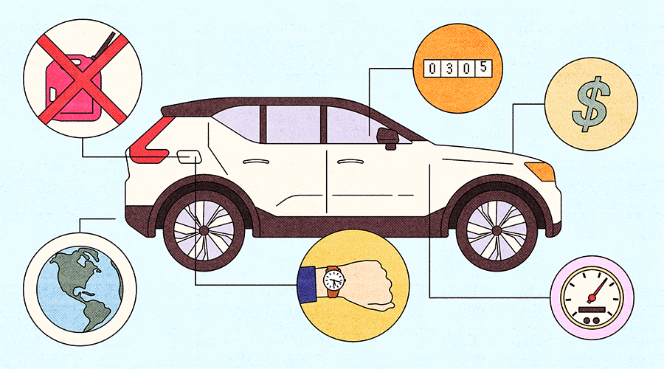

Data Overview
The variables taken into consideration for helping our customer choose between Fuel or Electric Car are:
Data Collection:
Price of Gasoline and Electricity of Dallas,Texas from US Energy Information Administration (eia).
Consumption of Gasoline and Electricity
Assumption & Uncertainties:
Working Days of an Employee.: 40 miles/day
Gathering Data on the work from home percentages for a time period.: 30% and 70%
Different vehicle Subsidies available.

Slide 6
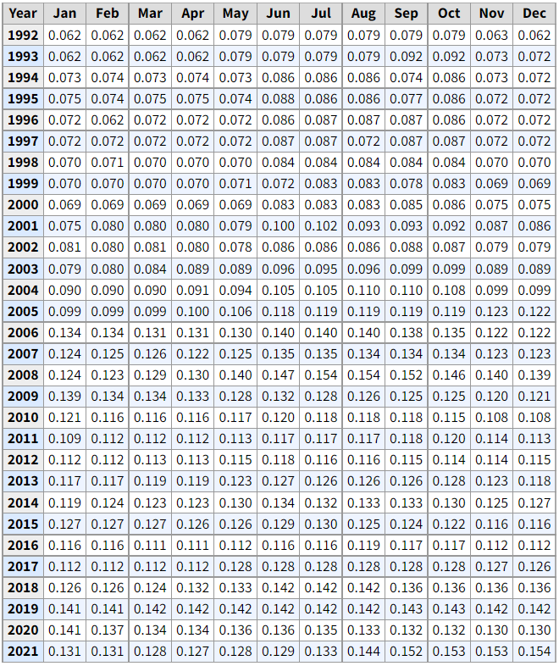

Electricity Price Data

Slide 7
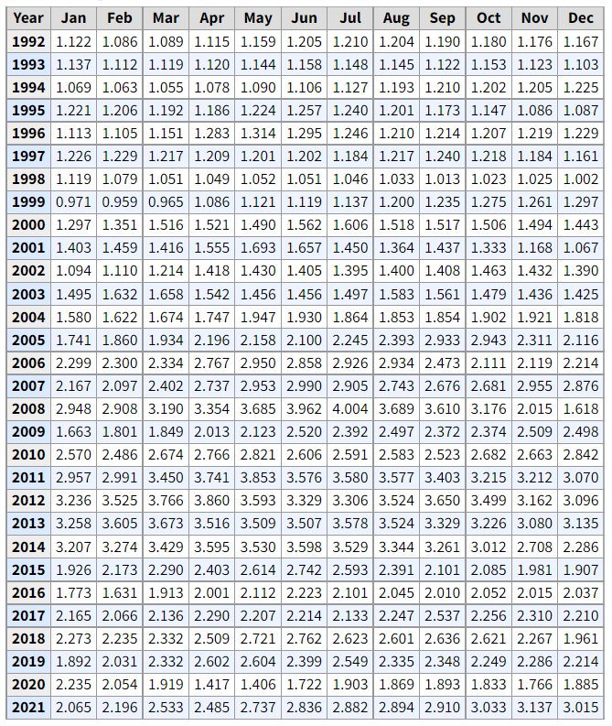

Gasoline Price Data

Slide 8
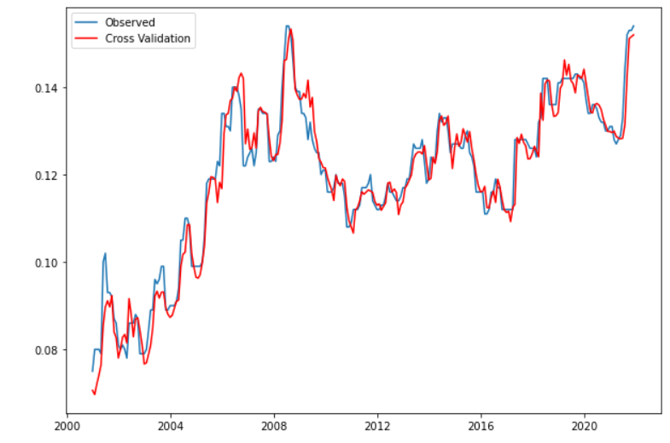
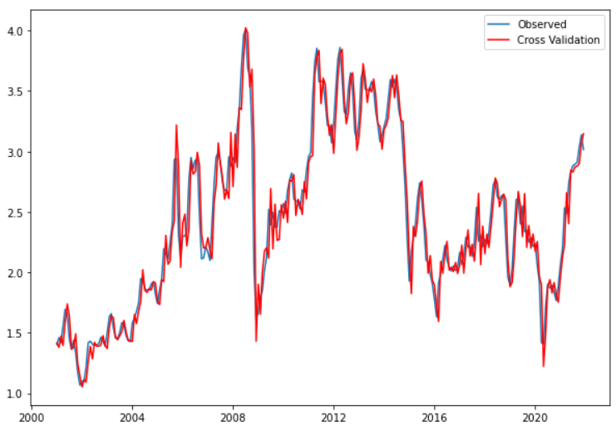
Cross Validation of the Data
Electricity
Gasoline

Slide 9
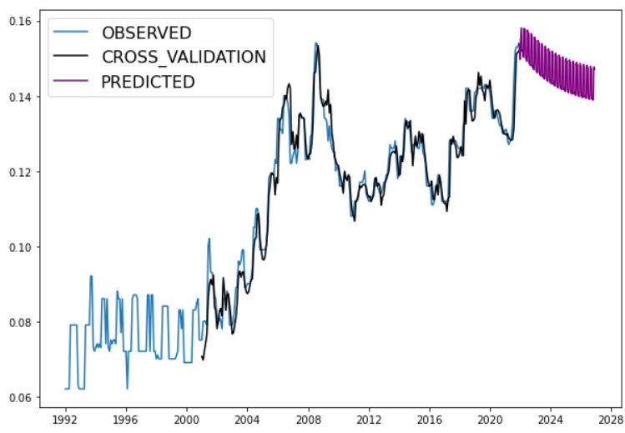
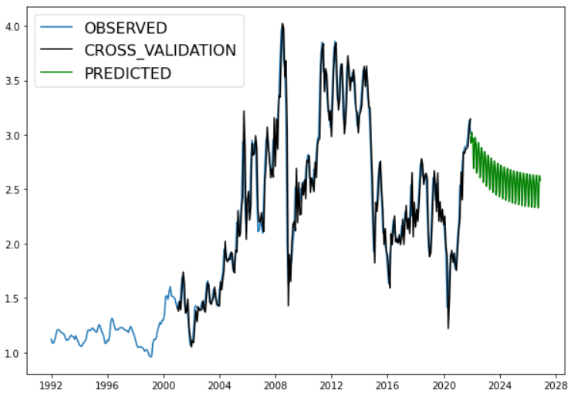
Forecasting prices of Electricity/ Gasoline Prices for
Next 5 Years
Electricity
Gasoline

Slide 10
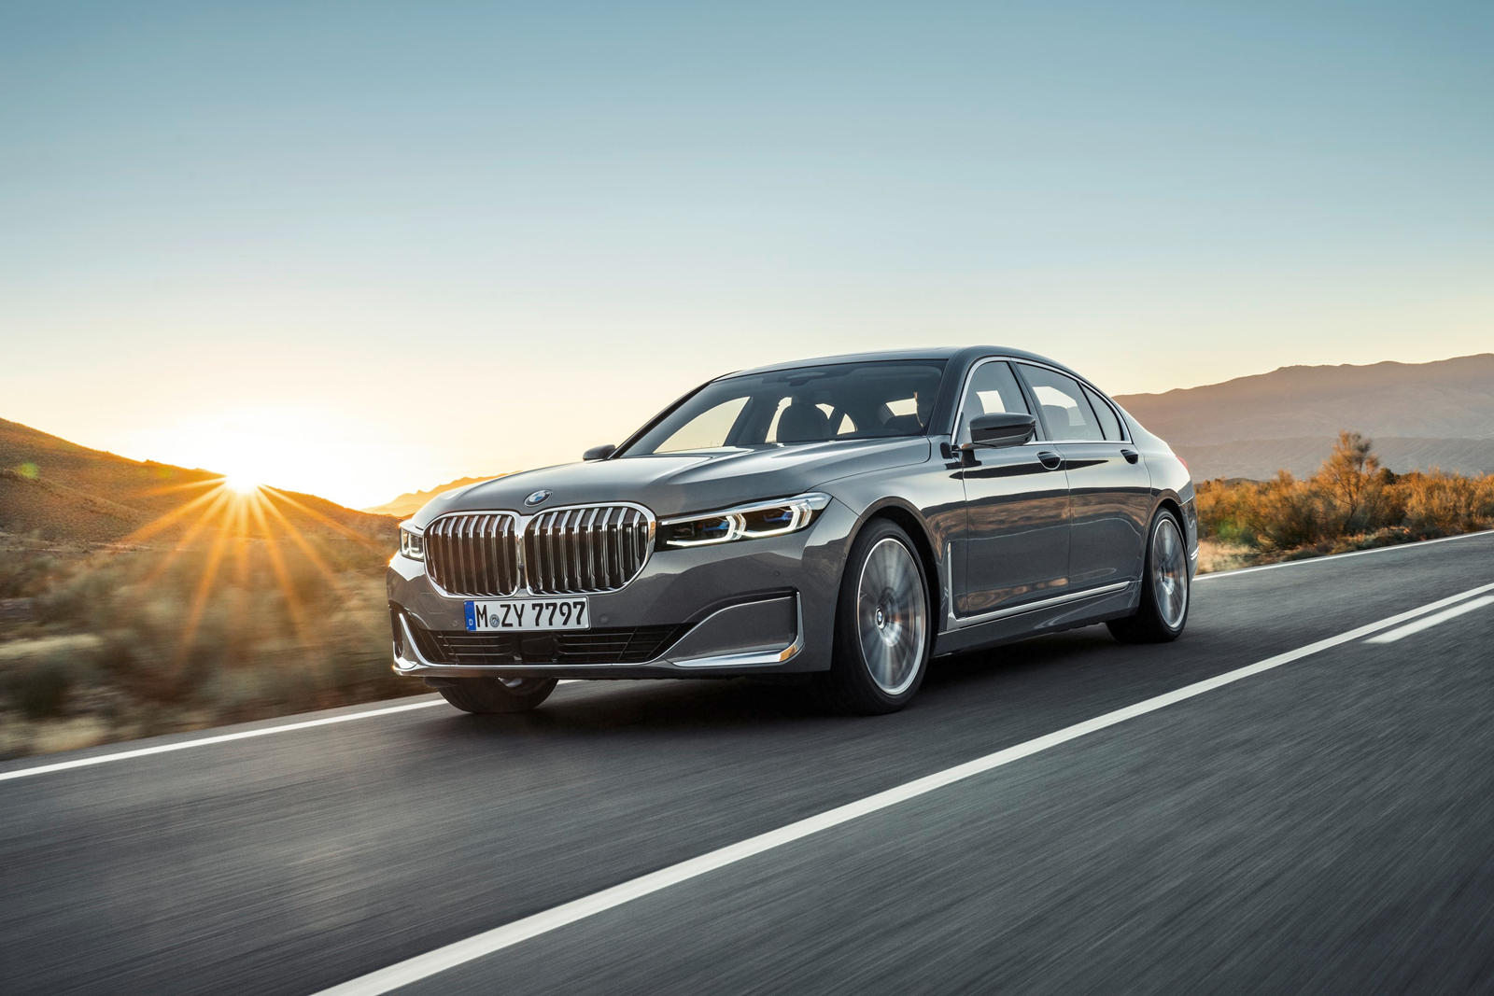
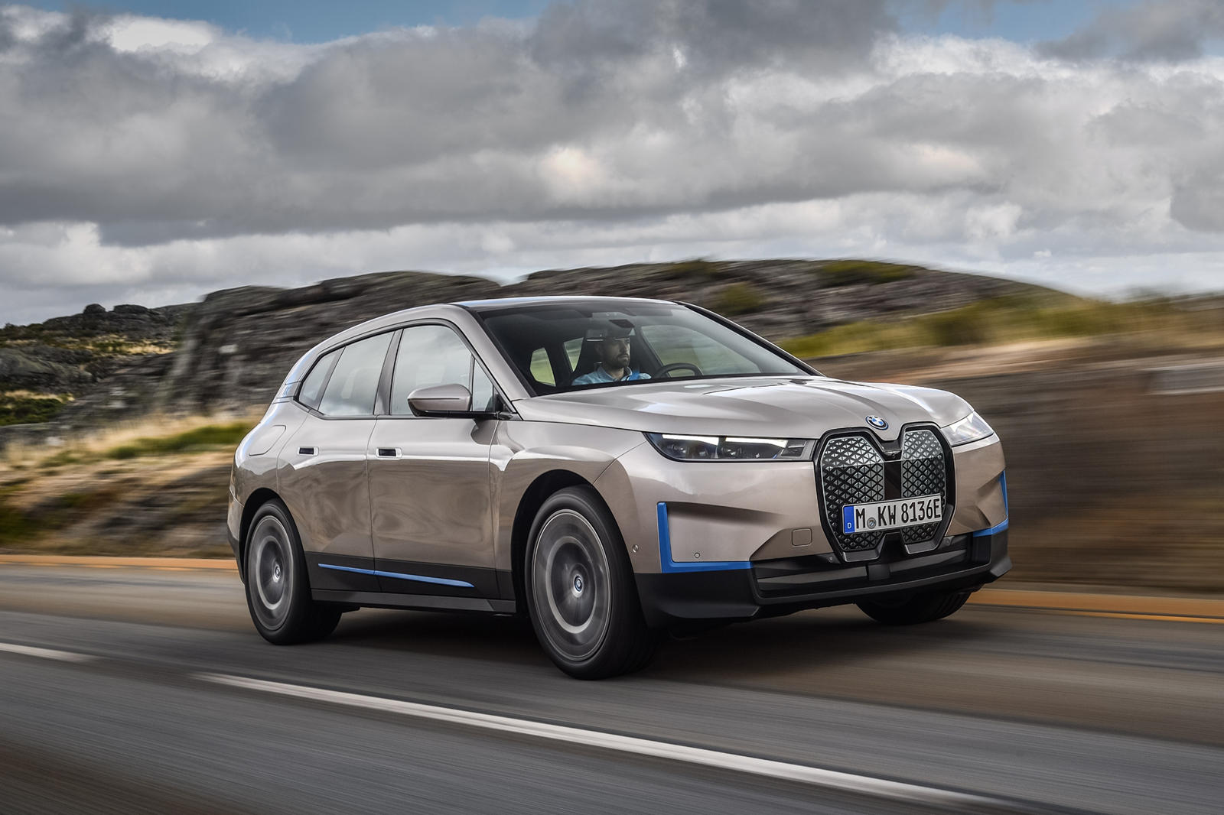
The cars
2022 BMW 7 Series
Engine : 3.0L Turbo Inline-6 Gas
2022 BMW iX
Engine : Electric

Slide 11
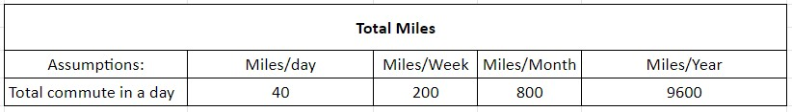
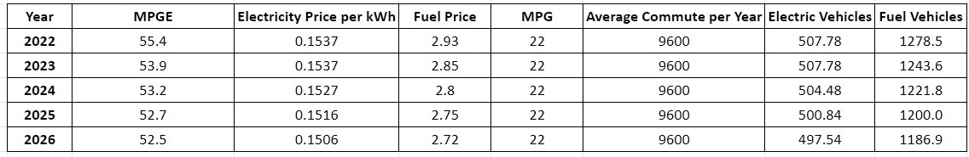
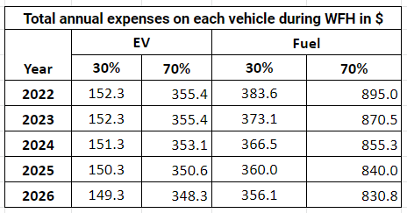
Decision Analysis Calculations

Slide 12
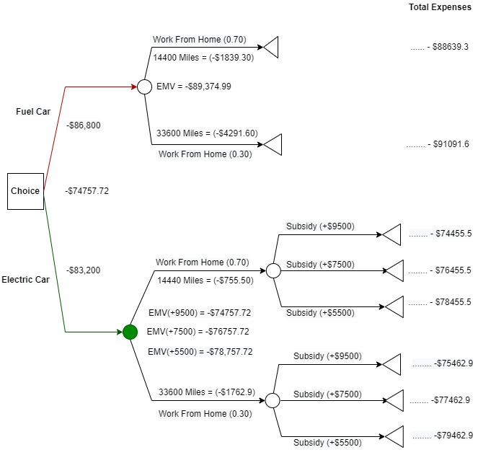

Decision Analysis
Notes:
Thank you Chandrashekar, Now, Continuing forward with the presentation, The decision analysis structure u see here has the price of th 2 cars which are 86800 and 83200 for Fuel and Ev respectively. Based on the question given to us we are taking into account the WFH uncertainties and the green energy subsidies and we are also calculating the distance customer is going to travel, the expenses he has to bare for the next 5 years. As chandrashekar mentioned in the previous slide we are considering the WFH uncertainties to be 70% and 30% also chandrashekar has explained about the calculations of expenses and the distance a customer travels for each year, and for the next 5 years. Now coming back to the decision analysis, Since the customer travels 9600 Miles an year for the next 5 years the Total distance he/she would travel is 48000 miles. Now moving on to the uncertainties if the Uncertainty of WFH is 70% it means that the customer will go to office only for 30%, so we calculated the 30% from total distance also 30% of the expenses for the next 5 years. Similarly for the 30% WFH uncertainty it means he/she will go to the office for 70% and we have calculated total miles to be travelled and the expenses for 5 years. This is the same process we followed for calculating WFH uncertainty for fuel car and Electric Car. Additionally only the EV has a Green Energy subsidy of 7500$ when the customer buys a new car whereas the fuel car doesn't hold any subsidies. Now based on the Expenses the customer has to spend along with the addition of car price and subsidiaries we have come up with the total expenses as u can see on the decision tree. After calculation of the Total expenses we backtrack the tree and find the Expected Monetary Value(EMV) to explain in details lets consider the Fuel car here we take the Total expense of the 1st branch which is 88639.3 and Multiply with the probability of that branch which is 0.70 and add up these 2 branch values which will give us the EMV for the fuel car node we do this similar process for the Electric Car Node and find the EMV. Like u see we come up 2 EMV values which are 89,374.99 and 76757.72 for the FV and Ev respectively,and the least EMV value is the best option to choose.

Slide 13

Insights and Findings
1
For the next 3-5 years the average price of fuel will be $2.75/gallon and for electricity will be $0.15/kwh.
2
For 1 year, we have 9600 miles to travel for the buyer. In this 1 year the expenses would be $507.78 (EV) and $1278.5 (Fuel vehicle).
3
After considering the WFH uncertainties for next 5 years, the expenses for the EV ranges from $149.3 to $ 355.4. Whereas for the fuel vehicle the expenses range from $356.1 to $895.0.
4
In addition to the low prices of electricity when compared to fuel prices for the next 5 years, there is also a benefit of $7500 tax credit on the purchase of EV. Hence, buying an EV would be more cost effective for the customer.
Notes:
Now to Summarize our findings,
We predicted the Electricty prices in 1kwh and the Fuel price in gallons for the next 5 years, If we see the expenses the electric vehicle spends in a year it is just 39% of the Fuel Car expense which is 1278.5$.
Even After taking the WFH uncertainties into the picture for the next 5 years, the maximum amount to be spent on electric vehicle in any 1 year of the 5 years is 355.4 which is not even the minimum of the a fuel vehicle.
In addition to the low price of spending on Ev we also have a subsidy of 7500$ when compared to nothing to the fuel car.
Taking all these into consideration, Buying an EV is more cost effective and efficient to the customer

Slide 14



Decision : Electric Car it is!
Notes:
'Going through all of the calculations and observing various outcomes we would recommend the customer to buy the Electric Car instead of a Fuel Car. Thank you and have a wonderful evening'

Slide 15

Thank You!
Enjoy your ride :)

Slide 16
Any Questions?

